Slide 1
CYBR 493A
Introduction
Lecture 1.A. : Introduction to Linux and Version Control
Pages 1-11

Slide 2
TOPICS
Costs of Data Breach Report 2021.
Gentle Intro. To Linux.
Common Linux commands to know
Absolute vs. Relative paths
Introduction to Version Control
Working with Git and GitHub
Introduction to Python

Slide 3
IBM SECURITY: COST OF DATA BREACH REPORT 2021
IBM releases annual reports summarizing the major risks in the cybersecurity industry.
The report offers IT, risk management and security leaders a lens into factors that can increase or help mitigate the rising cost of data breaches.

Slide 4
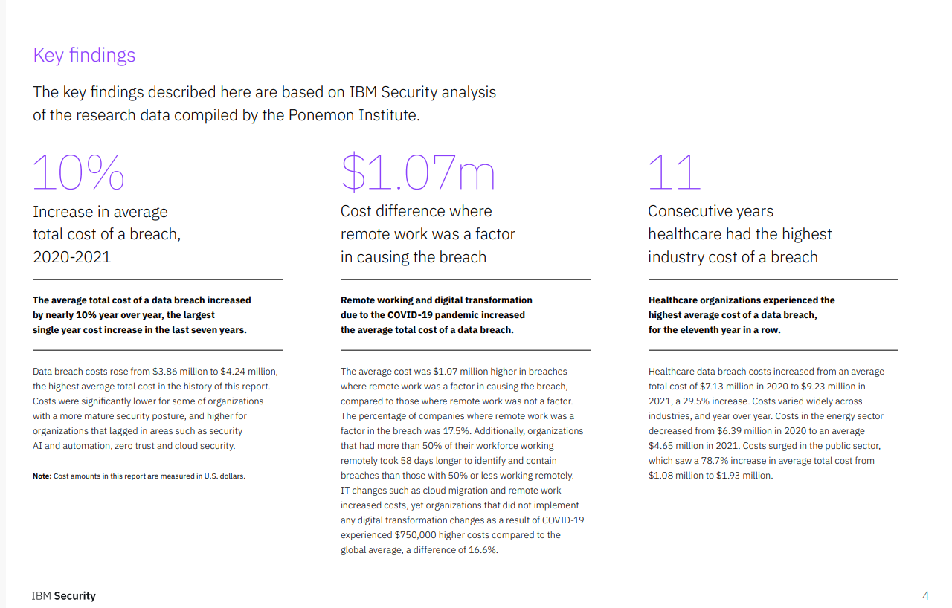
IBM SECURITY REPORT 2021: key findings 1/3

Slide 5
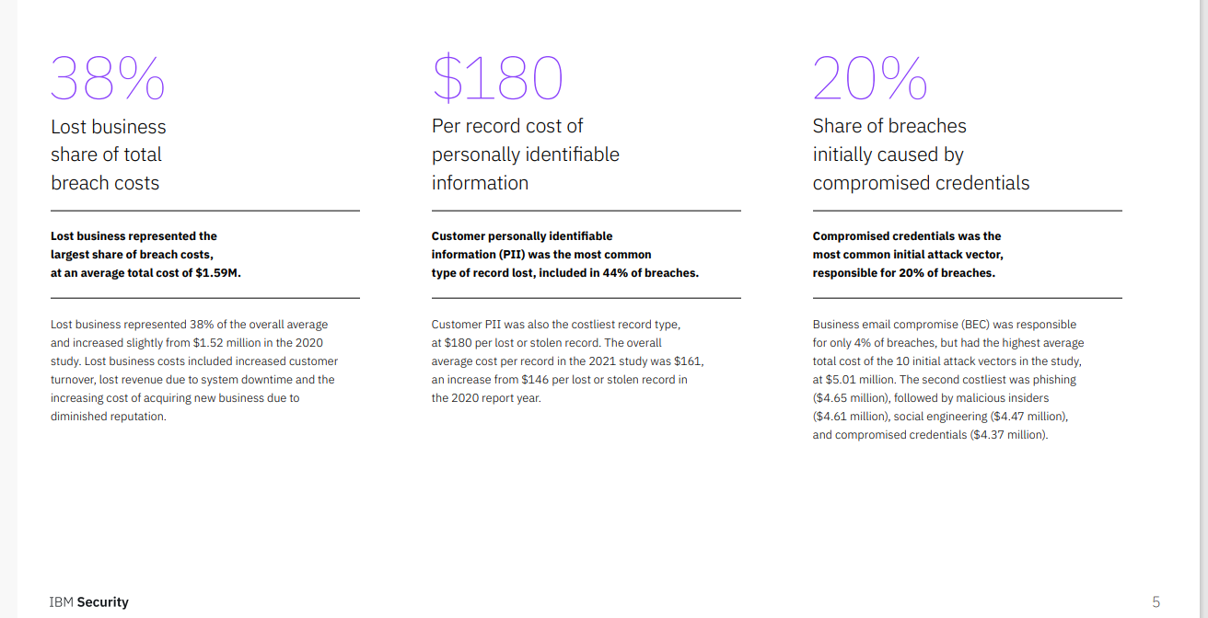
IBM SECURITY REPORT 2021: key findings 2/3

Slide 6
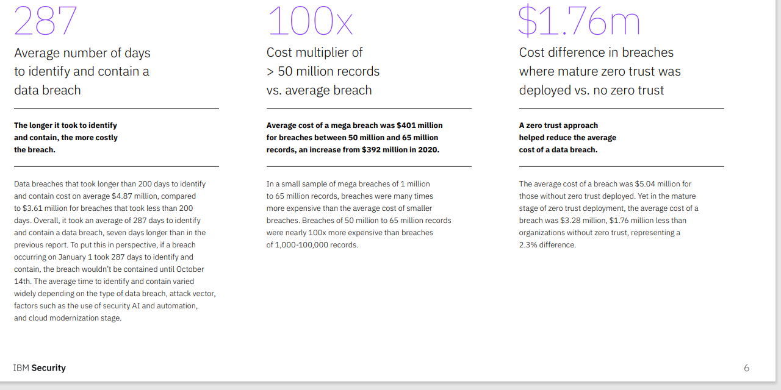
IBM SECURITY REPORT 2021: key findings 3/3

Slide 7
Why do we care?
The effect of cybersecurity attacks can not be underestimated.
Businesses with no means to detect, classify, report, and “fix” those attacks are not sustainable.

Slide 8
Let's talk Version Control
Version Control Systems are essential in developing computer software

Slide 9
Introduction to Version Control
Version Control, sometimes referred to as “revision control”, “source control”, and “source code management”, is a process of tracking changes to files over time.
One of the main goals of version control is to track changes that occur so that they can be reviewed and if necessary, rolled-back.

Slide 10
Version Control Systems
Imagine that you and your group members are working on a project/ paper
Each must contribute by adding files/ text
How do we track contributions?
What if somebody “deletes” content, can we retrieve them?

Slide 11
Version Control Systems: Git
There are a lot of version control systems in existence today. For this class we will be focusing on using Git:
A “distributed version control” system. Meaning you can keep a local repository on your computer (including history), and synchronize it with a remote repository

Slide 12
Working with Git and GitHub
You will need to create an account with Github
We will use the book’s repository as an example
Copy a template repo
Clone the repo to your local machine

Slide 13
Creating a GitHub account
To begin we will create an account on GitHub. To start:
Open a web browser and go to https://github.com
On the GitHub home page, click Sign up.
On the Create your account page, enter your desired Username, Email address (use Mix please) and Password.
Click to verify your account and solve the puzzle presented.

Slide 14
Cloning our repo
Now that we have an account on GitHub, we can start by cloning our repository
The book has a sample repository that can we can use to begin our process.
It is integrated in our main repo

Slide 15
Github Desktop
You may also use a user-friendly application named Github Desktop
You can do everything using the Github Desktop application.

Slide 16
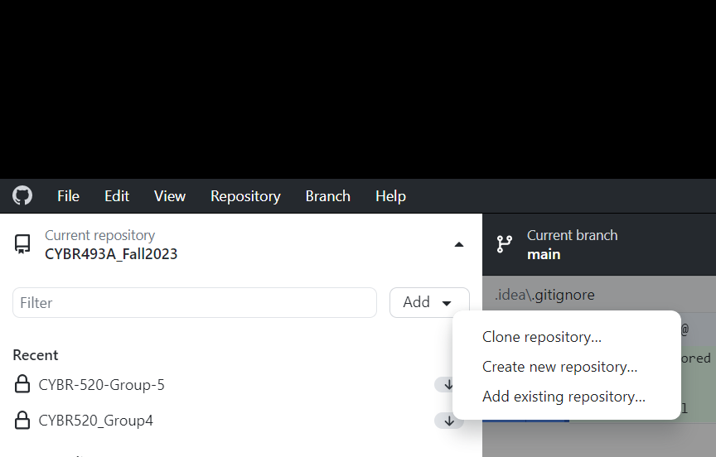
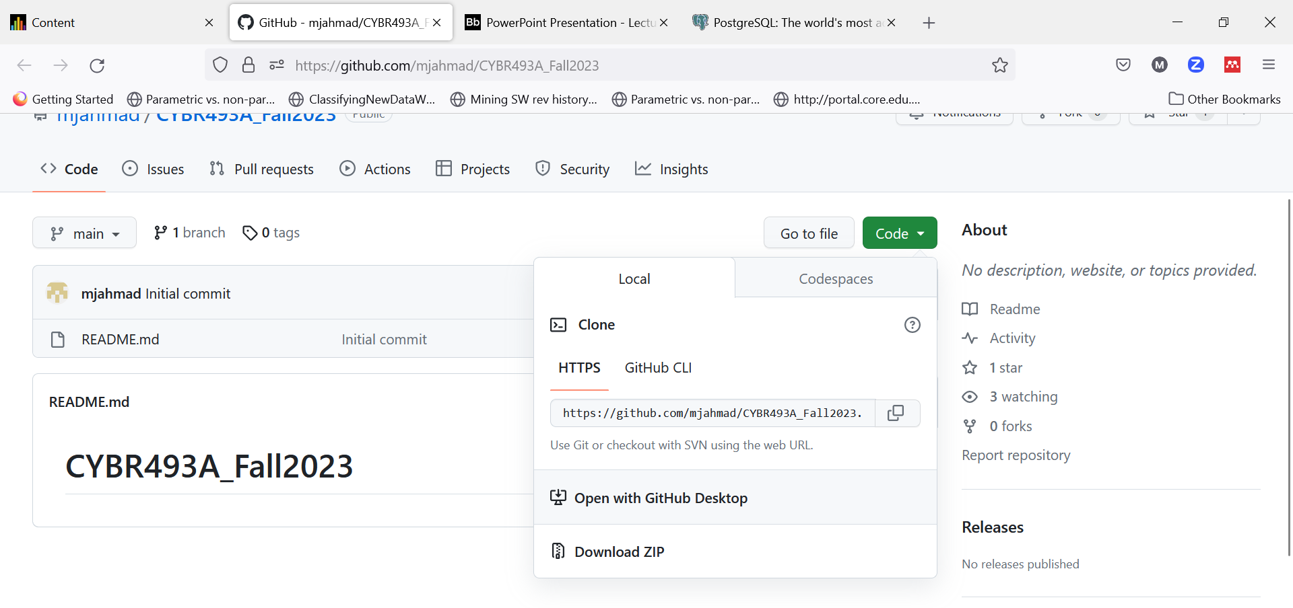
Install Desktop GitHub
Direct download and installation.
Then clone class’s repo to your local machine
Get the link from our Repo, copy link
Then in Desktop GitHub, clone.

Slide 17
Cloning our repo
In the web browser, go to https://github.com/mjahmad/CYBR493A-Fall-24.git , this is the our main repository, it also has the source code for the sample files in our main book.

Slide 18
Joining GitHub
Create an account on github, using your mix account.
Download and install Github Desktop
Create your own private repo
Name is [Your First Name]_[Your Last Name]_CYBR493A_Fall24.
Add Dr. Ahmad[mahmad2@mix.wvu.edu] as a contributor
Clone your own repo to your local machine
Clone our class Repo.

Slide 19
Let's talk Linux!
Fun fact, you are more likely to be hired/ get a competitive salary for knowing Linux =)

Slide 20
Linux- Introduction
Linux is an alternative operating system.
Mostly free.
Unix-like and POSIX-compliant (Portable Operating System Interface).
Open-source : source code is made available and licensed such that the copyright holder has the rights to study, change, and distribute the software to anyone for any reason.

Slide 21
Linux- Introduction
Four main parts of the Linux system:
The Linux kernel
The GNU (GNU’s Not Unix) utilities
A graphical desktop environment
Application software
There are different “flavors” of Linux
The most popular is Ubuntu Desktop

Slide 22
UBUNTU or Kali Linux
Ubuntu descends from one of the oldest and most revered Linux distributions, Debian.
Debian is assembled by a team of talented volunteers, is one of the most stable and customizable distributions of Linux and is well respected for its quality and technological prowess.
Ubuntu has leveraged the quality of Debian to create an operating system that ordinary people can use.
Does not mean its less complex than Linux. It carries all its features

Slide 23
Ubuntu: Where and how to download
You can download Linux or any distribution (Ubuntu Desktop) for free
Also refer to eCampus for Kali Linux link
You can install it as a standalone Operating Systems side by side with your Windows
If you do not wish to install it, you may use it using Ubuntu Virtual Machine

Slide 24
Ubuntu Installation
You will need the following:
ISO image of Ubuntu
With a bootable Ubuntu USB stick, you can:
Install or upgrade Ubuntu
Test out the Ubuntu desktop experience without touching your PC configuration
Boot into Ubuntu on a borrowed machine or from an internet cafe
Use tools installed by default on the USB stick to repair or fix a broken configuration
You may obtain either Rufus or balenaEtcher
These tool allow us making bootable USB
You may also install Grub Customizer (next class) to re-order boot options
To remove Ubuntu, see this video. Be careful, if you have BitLocker, make sure you have access to recovery key.
Or use virtual box => see this as well

Slide 25
The SHELL Utility 1/2
The shell is a special interactive utility.
Allows users to start programs, manage files on filesystem, and manage processes.
Core of shell is the command prompt, the interactive part of the shell.
Set of internal commands used to control things.
Kernel handles executing the commands

Slide 26
The SHELL Utility 2/2
We can also group shell commands into files to execute as a program.
These files are called shell scripts.
Any command that can be executed from the command line can be used in a shell script.
Example: Execute several programs consecutively, go away, come back, and programs are done.
You may access a free online terminal

Slide 27
Common Linux commands to know
pwd: find the current working directory
ls: list content of directory
cd: change working directory
Please look at an extensive list:
Book
HOSTINGER Tutorial
Linux for dummies

Slide 28
Absolute vs. Relative paths
Absolute path: relates to the location from the root directory to that file
Relative path: relates to the location of the file in terms of the current directory

Slide 29
Introduction to Python
Python is a “programming”/scripting language initially developed in 1989 by Guido van Rossum.
Many of main tenants for the Python programming language center around readability and simplicity, which has made it extremely accessible and easy to use.
Python is meant to be “fun to use” ☺

Slide 30
Introduction to Python
In recent years, the flexibility and usability of Python has resulted in its use growing rapidly.
Python has become a critical skill to know in several realms including:
Networking
cyber-security
systems management
data scientists
artificial intelligence

Slide 31
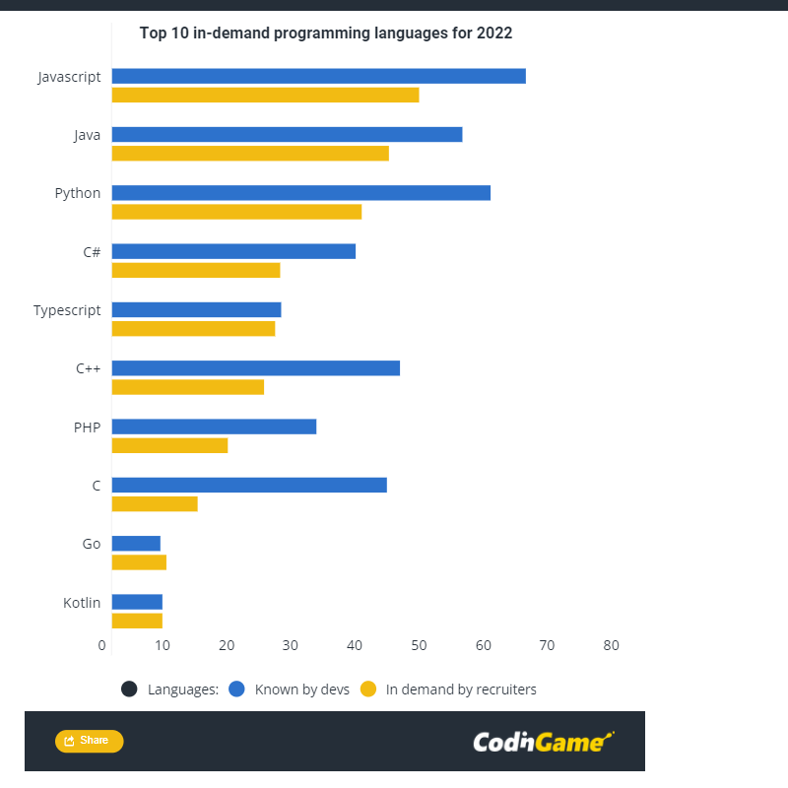
Introduction to Python

Slide 32
Simplest way to create a python file
We write source code and save them in files.
These are known as source code files
Source code files are nothing but text documents with fancy extensions:
Python => .py
C ++ => .cpp
Java => .java
What do you think extensions are used for?

Slide 33
Keep in mind
Your computer does not understand what Python/ Java/ C++ is.
For each programming/ scripting language, the OS needs a program understand it and execute it.
These are named compilers/ interpreter.
This is what we mean when we say, install Python.

Slide 34
Source code: file extensions
Each file consists of two parts:
Name
Extension
The extension tells the Operating System (and users) what kind of file this is
Also allows the PS to use certain programs (compiler/ interpreter) to run the file.

Slide 35
Create and commit the following files
One file named [your first name_last name.py]
One file named [your first name_last name.java]
If Python and Java are installed, these files should have different icons:
To check whether you have Python installed:
Go to Run => type cmd => type python and hit enter
You should see a black screen with >> waiting for input, otherwise, you will need to install python.

